Slide 1
Auto Resume Optimizer
Data Science Project
BY
Shivani Rekala

Slide 2

Motivation

Slide 3


Who see our resume first ?
Application Tracking System (ATS)
Recruiter

Slide 4
DESIGN
Skills
Skills Suggestions
Job Description
Extract Keywords
Projects
Project Suggestions

Slide 5
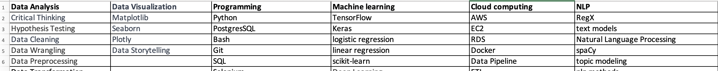
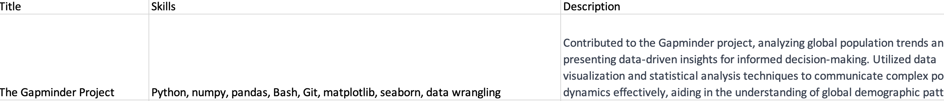
Data collection:
Job postings from Glassdoor
Data of 150+ data science skills from Spiced course material
Data of 11 week projects from bootcamp experience

Slide 6

when you don’t add keywords to your resume

Slide 7
Limitations
Dataset is restricted data science only.
The app solely provides suggestions

Slide 8
Future goals:
Expand the dataset for other job categories
Auto replace the suggested keywords and projects to resume

Slide 9







Tools:
Fuzzywuzzy

Slide 10
THANK YOU!

Slide 11

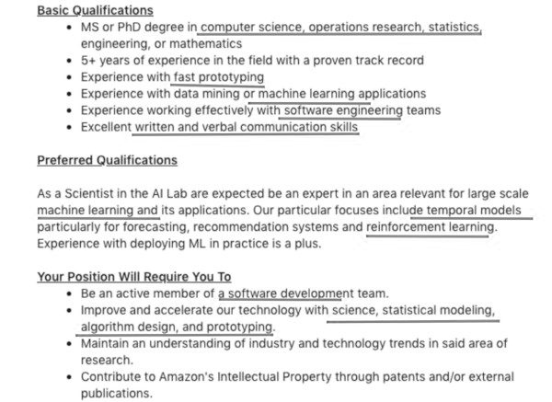
WHAT are Keywords?

Slide 12
Hard Facts:
The average time spent reading a resume is 6–7 seconds
Only 2–3% of sent resumes result in an interview
66% of large businesses and 35% of small businesses uses ATS to screen candidates
A PDF file is not a ATS friendly, so upload your resume as a word document
88% of resumes are rejected simply because there’s a photo
https://www.forbes.com/sites/ashleystahl/2023/06/07/how-to-write-a-resume-in-7-easy-steps/

Slide 13
Project Goal
Auto replace the keywords in resume according to job description
Apply for more jobs in less time

